Slide 1
Time Series
June 2024

Slide 2
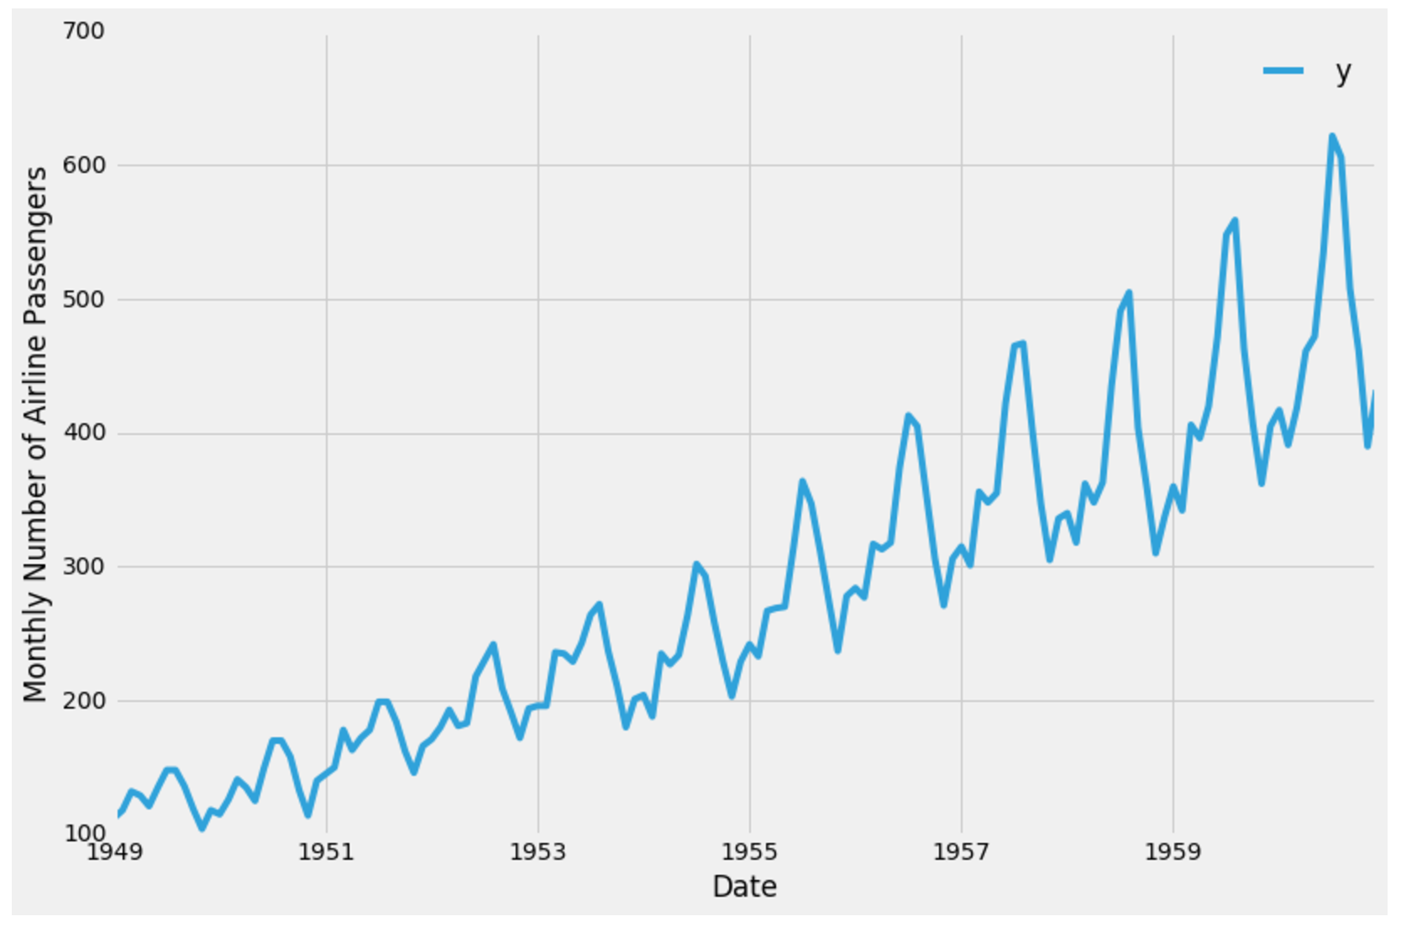
Time series
Time series can be defined as a sequence of a metric is recorded over regular time intervals. Depending on the frequency, a time series can be of yearly, quarterly, monthly etc.
There is one thing which Time-series make different from the regular regression problem. It is Time-dependent. In linear regression models, observations are independent but, in this case, observations depend on time.

Slide 3
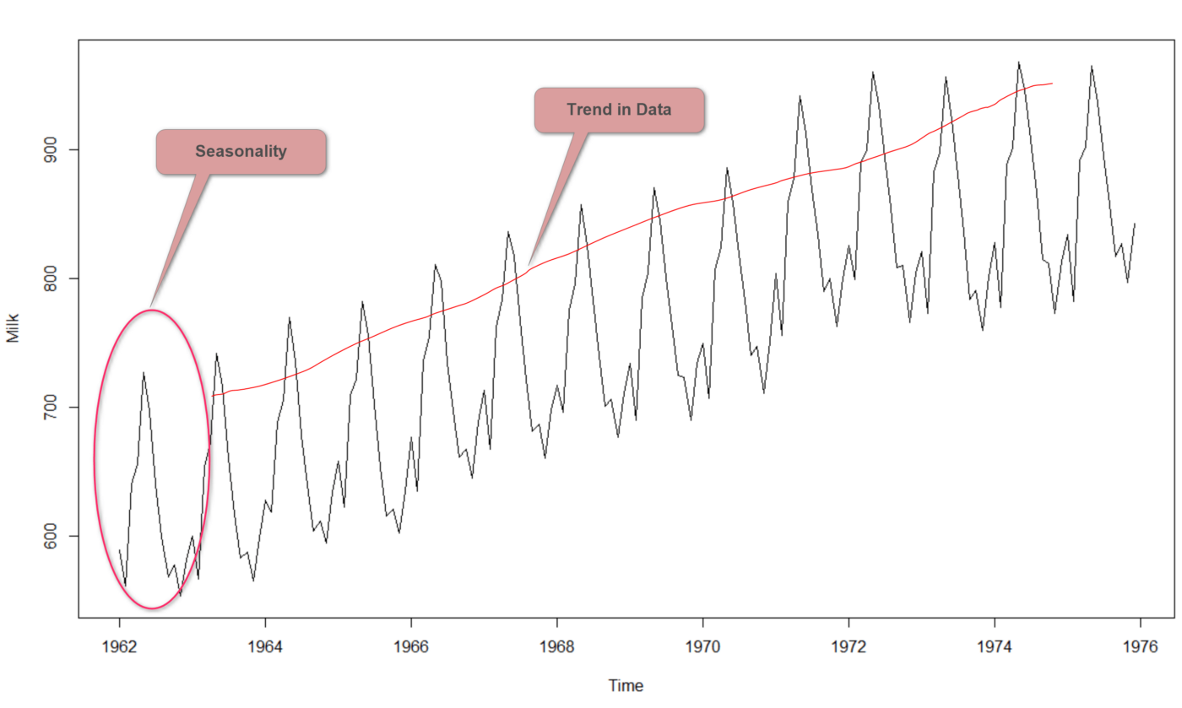
Time series elements
Trend
The trend is showing the general tendency of the data to increase or decrease with time.
Seasonality
Seasonality in a time series is a regular pattern of changes that repeats over S time periods, where S defines the number of periods until the pattern repeats.
For example, if we think about ice cream sales in several years, there will be a high number of sales in summer and low sales in winter. So, this pattern repeats for years. So, the S would be 12.

Slide 4
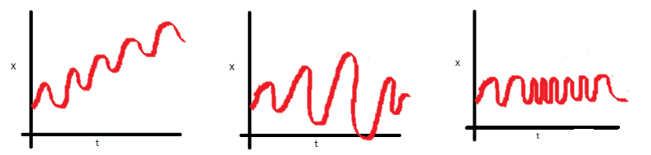
Stationary
Stationarity means that the statistical properties of a time series which are mean, variance and covariance do not change over time.
In the first plot, mean varies (increases) with time which results in an upward trend.
In the second plot, no trend in the series, but the variance of the series is a vary over time.
In the third plot, the spread becomes closer as the time increases, which means that the covariance is varying over time.

Slide 5
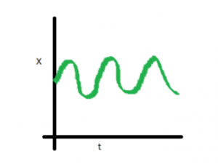
Stationary
In the following diagram, all three properties are constant with time which stationary time series looks like.

Slide 6
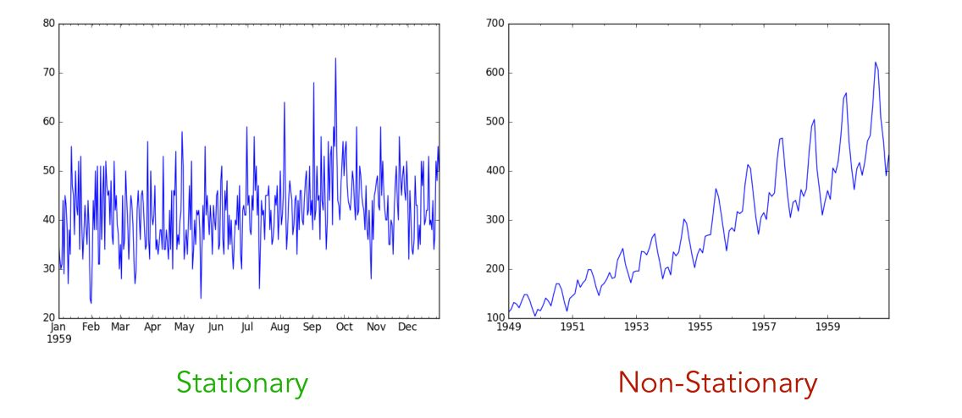
Identifying stationary
We can use several methods to identify whether the time series is stationary or not.
Visual test which identifies the series simply by looking at each plot.
2. ADF (Augmented Dickey-Fuller) Test which used to determine the presence of unit root in the series.

Slide 7
Time series forecasting
There are 2 methods used for time series forecasting.
Univariate Time-series Forecasting: only two variables in which one is time, and the other is the field to forecast.
Multivariate Time-series Forecasting: contain multiple variables keeping one variable as time and others will be multiple in parameters.

Slide 8
Making a Time Series stationary by differencing
In order to use time series forecasting models, first, we need to convert any non-stationary series to a stationary. One method is to use the differencing method. Differencing is simply performed to remove the varying mean.
In this method, the current value is subtracted by the previous value. The complexity of the time-series causes the number of times that the differencing is needed to remove the seasonality.

Slide 9
Seasonal differencing
It is the difference between a value and a value with lag that is a multiple of S. S denotes the frequency of the season.

Slide 10
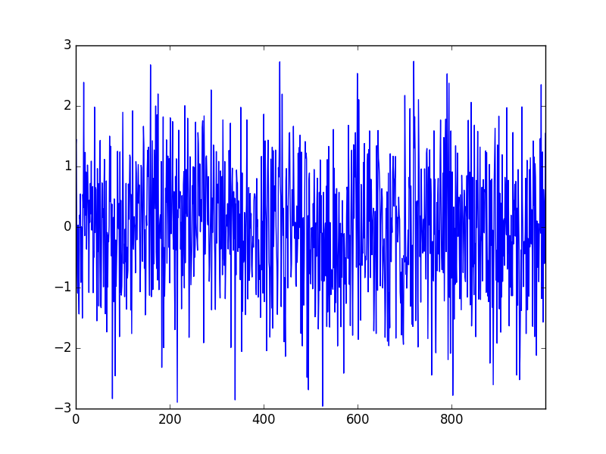
White noise time series
Simply the “white” means all frequencies are equally represented and “noise” is because there’s no pattern, just random variation.
A time series is a white noise if it distributed with a mean of zero, constant variance and a zero correlation between lags.
Formally, we say that ε is a white-noise process if

Slide 11

AR model
Auto-Regressive (AR only) model is one where the model depends only on its own lags.

Slide 12
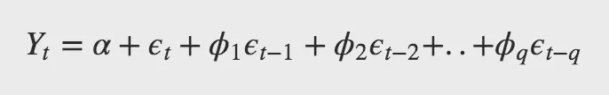
MA model
Moving Average model is one where the model depends only on the lagged forecast errors which are the errors of the AR models of the respective lags.

Slide 13
ARMA model
The Autoregressive-moving average process is the basic model for analyzing a stationary time series. ARMA model is about merging AR and MA models.

Slide 14
ARIMA model
Auto-Regressive Integrated Moving Average aka ARIMA is a class of models that based on its own lags and the lagged forecast errors. Any non-seasonal time series that exhibits patterns and is not a random white noise can be modelled with ARIMA models.
ARIMA model is characterized by 3 terms:
p is the order of the AR term where the number of lags of Y to be used as predictors
q is the order of the MA term where the number of lagged forecast errors that should go.
d is the minimum number of differencing needed to make the series stationary.

Slide 15
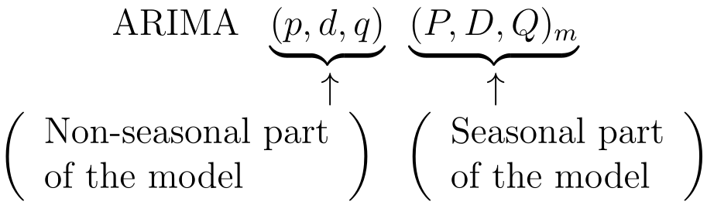
SARIMA model
In a seasonal ARIMA model, seasonal AR and MA terms predict using data values and errors at times with lags that are multiples of m(the span of the seasonality).
Non-seasonal terms(p,d,q): Can use ACF and PACF plots for this. By examining spikes of early lags ACF indicates MA term(q). Similarly, PACF indicates the AR term(p).
Seasonal terms(P, D, Q and m): For this need to examine the patterns across lags that are multiples of m. Most cases first two or three seasonal multiples would be enough for this. Use the ACF and PACF the same way.

Slide 16
Questions?

